Slide 1


Review-2
Ear-Wearable SpO₂ and Heart-Rate Monitoring Device for Low-Ventilation Area Workers
AY 2025-26
Capstone Project – Introduction (PROJ2999)
GITAM (Deemed-to-be) University
Department of Electrical Electronics and Communication Engineering
Project Team:
Monisha H S – BU22EECE0100439
Prajwal Shetty – BU22EECE0100434
Project Mentor: Mr. Kshitij Shakya
Project In-charge: Mr. Jaya Praksh Sahoo
www.gitam.edu

Slide 2
Objective and Goals
Objectives
This project aims to develop a setup that simulates blood-flow patterns using a controlled water-flow system.
The purpose of this system is to support the testing and evaluation of heart-rate and SpO₂ sensors in a safe and repeatable manner.
Instead of using AI/ML algorithms, the system now focuses on hardware-based implementation using Arduino IDE, where sensors and actuators are directly controlled and monitored.
The water-flow mechanism helps mimic the behavior of real blood flow, allowing us to analyze how sensors respond to different flow conditions.
The goal is to create a simple, reliable, and practical testing platform that helps in future development of ear-wearable health-monitoring devices, especially for detecting low-oxygen conditions in workers from low-ventilation environments.
Goals
MAIN GOALS:
Develop a hardware setup using Arduino to simulate blood-flow patterns through controlled water flow.
Use water-flow and float sensors to study the behavior and response of heart-rate/SpO₂ sensor testing conditions.
Achieve stable and continuous flow for accurate simulation and testing.
Ensure the system is simple, reliable, and suitable for validating future ear-wearable sensor designs.
ADDITIONAL GOALS:
Add NodeMCU for wireless monitoring (optional future upgrade).
Improve system efficiency and power usage using lithium-ion battery support.
Enable continuous data observation for deciding low-oxygen conditions and the need for an ear-wearable SpO₂ sensor.

Slide 3
Introduction to SpO₂ Monitoring for Workers
Introduction
This project develops an ear-wearable SpO₂ monitoring device for workers in low-ventilation areas. It provides continuous, hands-free oxygen level tracking to prevent dizziness, fatigue, and accidents. The system ensures better safety by giving real-time alerts when oxygen levels drop.
What is SpO₂?
SpO₂ means Oxygen Level in Blood.
SpO₂ (Saturation Peripheral Oxygen)- Peripheral Capillary Oxygen Saturation.
It tells how much oxygen your body is getting.
Normal range: 95% to 100%.
If SpO₂ becomes low → the person starts feeling weak, dizzy, tired, fatigue, loss of consciousness.
Why Workers Need It?
Workers in places like mines, tunnels, factories, and low-ventilation rooms face low oxygen because of:
Poor air flow
Closed environment
Harmful gases
Dust and heat
Problem With Current Devices
Normal finger oximeters need hand to be free
Workers cannot wear them during work
They don’t give continuous monitoring
They are not comfortable
Not useful while moving

Slide 4
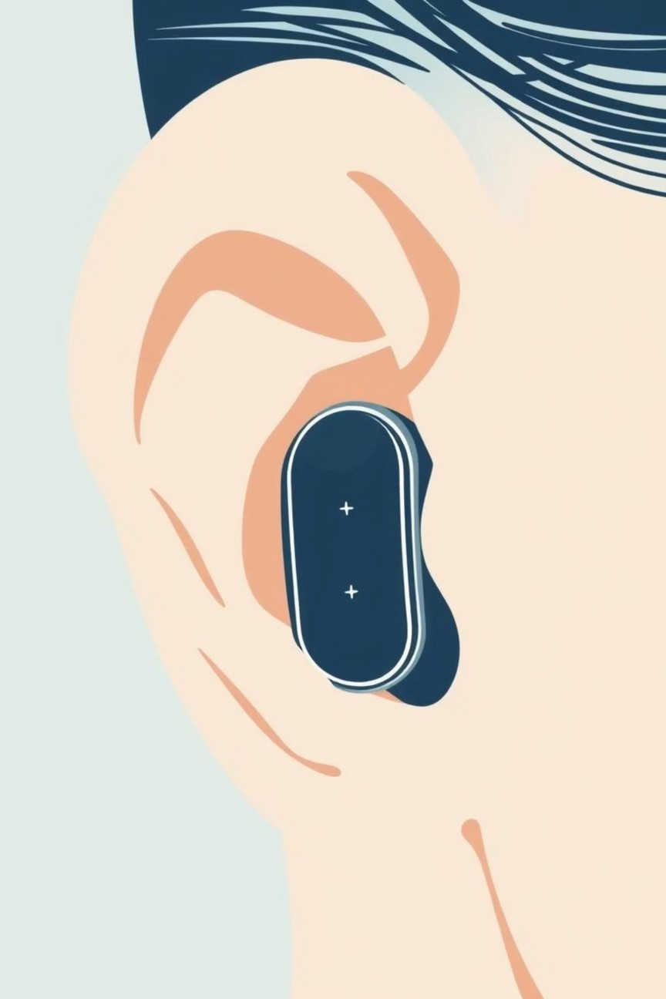
Ear-Wearable SpO₂ Monitoring System – Project Overview
Why Ear?
Ear has less movement → more accurate reading
Ear skin is thin → better light passing for sensor
Comfortable for workers
Worker can wear it for long hours
Hands stay free
Components Used (Hardware)
SpO₂ Sensor – uses red & infrared light to measure oxygen
Microcontroller (ESP/Nodemcu) – processes the sensor data
Bluetooth – sends data to phone or monitoring system
Accelerometer – reduces errors due to movement
Battery – powers the device
Buzzer/Vibration Motor – gives warning alert
Expected Output of the Project
Working prototype placed at the ear
Continuous real-time SpO₂ and heart rate
Alerts when oxygen is low
Useful for workers in low ventilation areas
Can be extended in future with body temperature, ECG, fatigue tracking, etc.

Slide 5
Project Plan

Slide 6
Literature Survey
Key Publications (IEEE & Scholarly Papers)
Title | Authors | Advantages / Why Useful | Key Takeaways
Wearable Photoplethysmography for Cardiovascular Monitoring | P. H. Charlton, P. A. Kyriacou, et al. | A comprehensive survey in IEEE on how PPG is used in wearables | Explains sensor design, signal processing challenges, motion artefact handling, and future research directions for wearable PPG systems
Photoplethysmography in Wearable Devices | K. B. Kim et al. | Good coverage of fundamentals and trends of PPG in wearables | Describes how PPG works, challenges in wearable context (motion, ambient light), multi-wavelength setups
In-Ear SpO₂: A Tool for Wearable, Unobtrusive Monitoring of Core Blood Oxygen Saturation | H. J. Davies, I. Williams, N. Peters, D. Mandic | Shows feasibility of ear canal SpO₂ measurement compared to finger | Found RMS error ~1.47%, mean offset ~0.23%, and ~12.4 s faster detection in ear vs finger; also discusses lower amplitude in ear signals
Development of a Wearable Reflection-Type Pulse Oximeter | P. P. Banik et al. | Demonstrates motion-aware SpO₂ and HR measurement in a wearable device | Reports performance under motion: 4.5% MAPE, 3.66 bpm MAE in motion, and ~98.96% SpO₂ accuracy without motion
Reduction of Motion Artifacts from PPG Signals using Learned Convolutional Sparse Coding | Giulio Basso, Xi Long, Reinder Haakma, Rik Vullings | A novel method for PPG denoising using a blend of sparse coding + learning | Demonstrates improved SNR and lower error in heart-rate estimation under motion compared to conventional methods

Slide 7
Literature Survey
Key Resources (Datasheets / Whitepapers / Application Notes)
Resource | What It Provides | How It Helps You
Arduino UNO Datasheet / Documentation | Pin configuration, voltage limits, I/O behavior, library support | Helps you correctly interface float sensor, relay module, and water-flow sensor
Relay Module Datasheet (5V) | Operating voltage, trigger level, load ratings, wiring guidelines | Ensures safe switching of the water pump without damaging the Arduino
Float Sensor Datasheet / Reference Guide | Working principle, switching logic (NO/NC), water-level detection method | Helps detect tank empty/full conditions and control pump operation accurately
Water-Flow Sensor (YF-S201 or Similar) Datasheet | Flow rate measurement formula, pulse output details, calibration method | Allows accurate reading of water-flow patterns to mimic blood-flow behavior
DC Water Pump Specifications (6V Pump) | Flow rate, pressure rating, power consumption | Helps decide pump suitability, flow stability, and system performance
Battery (Li-ion 3.7V / 18650) Documentation | Discharge characteristics, safe usage, protection guidelines | Ensures safe powering of the system and prevents voltage-drop issues
Arduino Libraries & Sample Codes | Pre-developed code for sensors, interrupts, timing functions | Reduces development time and ensures reliable code implementation

Slide 8
Literature Survey
Existing Implementations
PRODUCTS:
OxiWear – FDA-approved ear-worn pulse oximeter
Masimo MightySat / Temple-worn sensors
Smart Earbud with built-in SpO₂ monitoring
Headband/Temple-mounted SpO₂ monitors
Open-Source / GitHub Projects
Arduino MAX3010x libraries
DIY ear-clip PPG sensor projects
Earbud pulse oximeter prototype (MAX30102 + Arduino)
Wearable PPG toolkit for signal processing
BLE-enabled ear-lobe SpO₂ sensor (student project)

Slide 9
Use Cases & Testing
Use Cases
1. Sensor Testing Platform
A safe and controllable setup for testing heart-rate and SpO₂ sensors without using real human blood flow.
2. Flow Simulation for Research
Helps mimic blood-flow patterns using water to support research work related to sensor calibration and accuracy.
3. Prototype Validation
Allows early-stage verification of how sensors respond to different flow conditions before moving to actual biological testing.
4. Safety & Reliability Checks
Ensures that sensor-based health monitoring systems respond correctly under different flow levels (normal / low flow).
5. Data Observation & Interpretation
Enables collection of flow-based data to analyze how future wearable sensors may detect low-oxygen condition
6. Controlled Environment Experimentation
Provides a repeatable, non-biological test environment where flow variations can be artificially created and observed without safety risks.
Fault Detection & System Robustness Testing
Useful for checking how sensors and the Arduino-controlled system behave during disturbances such as pump failure, sensor disconnection, or sudden flow loss.
8. Educational & Lab Demonstration Tool
Acts as a practical demonstration model for understanding fluid dynamics, sensor behavior, and embedded system control for academic labs and student projects.

Slide 10
Use Cases & Testing
Testing Approach
Hardware Testing
Verify water-flow sensor readings at low, medium, and high flow levels.
Check float sensor activation when the water level drops.
Confirm relay switching response time and accuracy.
Ensure pump receives correct voltage and runs without interruption.
Flow Behavior Testing
Observe changes in flow when pump speed varies.
Measure stability of continuous flow over longer durations.
Test flow interruption and recovery to mimic pulse-like behavior.
Check for air bubbles or turbulence affecting readings.
System Testing
Simulate low-flow and no-flow conditions and monitor system reaction.
Validate pump ON/OFF logic when tank is full or empty.
Inspect for leaks, loose connections, or overheating.
Test overall reliability during extended operation.
Future Sensor Integration Testing
Record flow data to compare with real heart-rate/SpO₂ sensor readings.
Determine correlation between flow variation and sensor output changes.
Decide whether an ear-wearable sensor is necessary for low-oxygen detection.
Validate compatibility of additional sensors with existing Arduino setup.

Slide 11
Implementation and Results – Iteration 1
Iteration 1 : Results
IMPLEMENTATION:
Completed detailed literature survey on wearable SpO₂ sensors and ML approaches.
Finalized component selection → MAX30100/30102 sensor + Arduino/ESP32.
Designed system architecture (block diagram + flow chart).
Identified ML approach (classification model for anomaly detection).
RESULTS:
Validated that ear-based SpO₂ monitoring is feasible and more stable than finger sensors (from references).
Confirmed design feasibility for industrial use case.
Reviewed public PPG datasets for training reference.
Defined clear roadmap for hardware setup.

Slide 12
Implementation and Results – Iteration 2
Iteration : Results + Validation
REVIEW-1 TO REVIEW-2 CHANGES:
Removed AI/ML part from the earlier project plan.
Shifted focus to practical implementation using water-flow simulation.
Developed sensor + pump control system using Arduino and relay.
Concentrated on sensor behavior, flow stability, and data collection.
WORKING OF THE SYSTEM:
Water-flow sensor measures flow movement and consistency.
Float sensor detects water availability in the tank.
Arduino reads sensor status and switches relay ON/OFF.
Relay controls the water pump to maintain continuous flow.
This flow is used to mimic blood-flow behavior for testing HR & SpO₂ sensors.
COMPONENTS USED:
Arduino Uno
NodeMCU
5V Relay Module
Lithium-ion Battery 3.7V
Water Float Sensor
6V Water Pump
Jumper Wires

Slide 13
Implementation and Results – Iteration 2
Iteration : Results + Validation
CODE USED (ARDUINO):
#define sensorPin 2 // Switch / sensor
#define relayPin 3 // Relay control
void setup() {
pinMode(sensorPin, INPUT_PULLUP);
pinMode(relayPin, OUTPUT);
Serial.begin(9600);
}
void loop() {
int sensor = digitalRead(sensorPin);
if (sensor == HIGH) {
// Water tank empty → Pump ON
digitalWrite(relayPin, HIGH);
Serial.println("Pump ON");
}
else {
// Water available → Pump OFF
digitalWrite(relayPin, LOW);
Serial.println("Pump OFF");
}
delay(200);
}

Slide 14
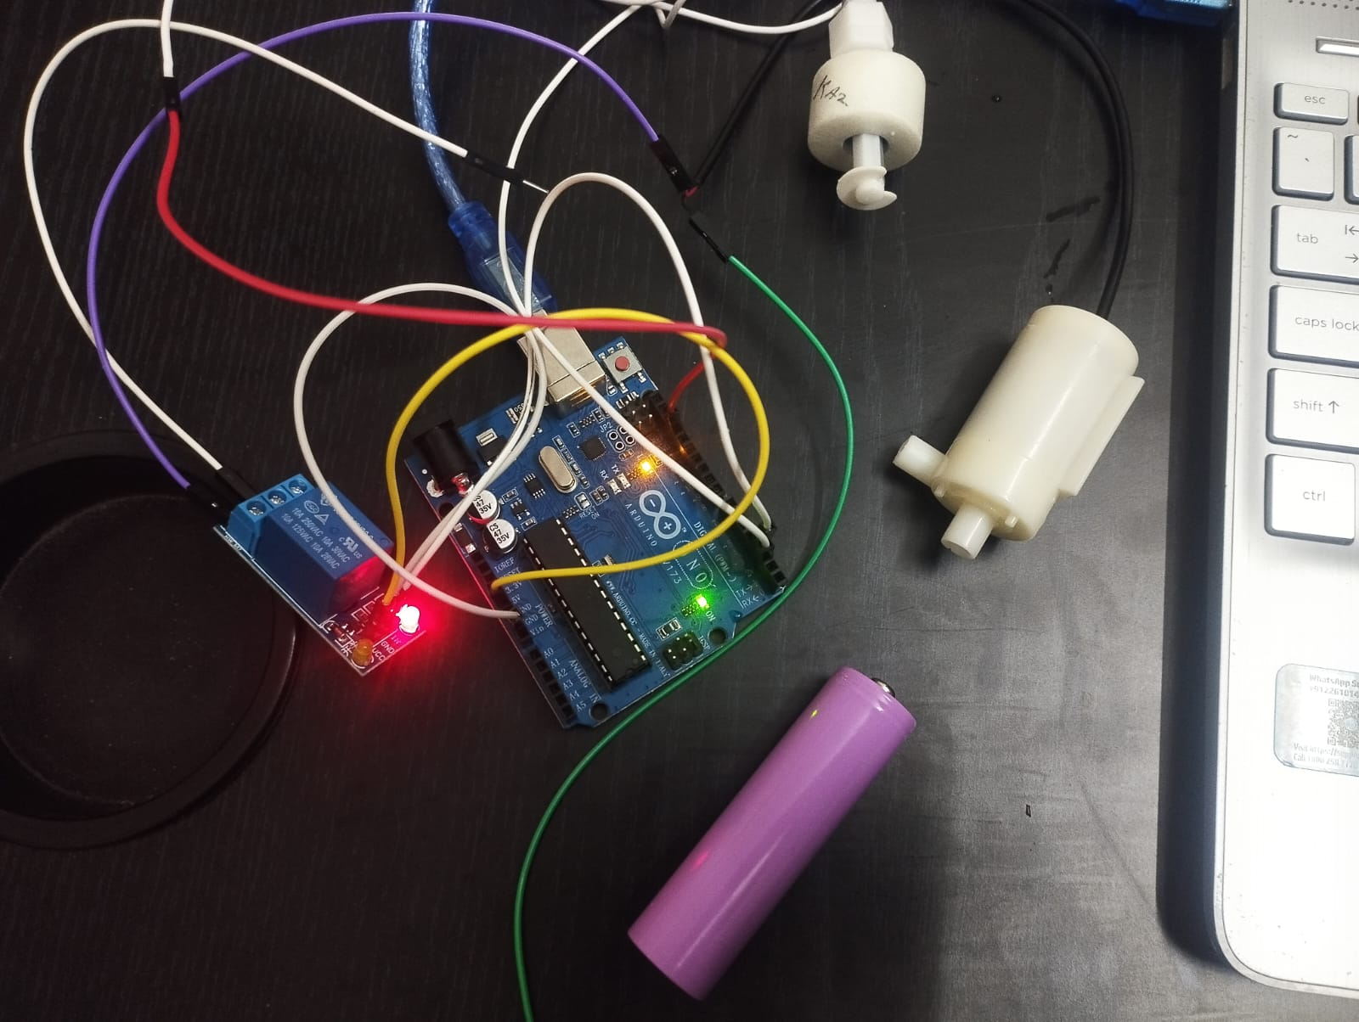
Implementation and Results – Iteration 2
Iteration : Results + Validation
IMPLEMENTATION & RESULTS (SO FAR):
Water pump successfully controlled using float sensor input.
Continuous water flow achieved for stable simulation.
All components tested and properly integrated.
Able to read flow data that replicates real blood-flow behavior.
System responds correctly to tank water levels.
EXTENDED IMPLEMENTATION RESULTS:
Verified relay switching accuracy using oscilloscope and Arduino serial logs.
Confirmed float sensor hysteresis (smooth switching without noise or false triggering).
Checked wiring integrity and power stability using a 3.7V Li-ion battery supply.
Validated system safety by ensuring the pump turns OFF during tank dry condition.
Measured flow behavior variations by adjusting water height and tube diameter.
Recorded sensor output patterns to analyze consistency in water-flow changes.
Observed stable pump operation without voltage drops or irregular flow.
Figure: Arduino-based water-flow simulation setup with relay, float sensor, and pump.
Project Demonstration - Video Link

Slide 15
Conclusion & Future Work
Conclusion (So Far)
The literature survey shows that a safe and controlled simulation environment is required before testing heart-rate and SpO₂ sensors on real subjects.
A water-flow based blood-flow simulation system has been designed and implemented using Arduino, relay module, float sensor, and water-flow sensor.
The system successfully generates stable and repeatable flow patterns, which can be used for validating future wearable sensors.
The project is feasible and provides a strong foundation for future integration of real heart-rate/SpO₂ sensors.
Summary of Work Completed
Conducted literature review on flow-based biological simulation setups.
Designed the complete system using Arduino UNO, relay module, float sensor, and pump.
Implemented pump control using float sensor to maintain continuous water flow.
Tested water-flow sensor readings under different flow conditions.
Validated stable flow generation for upcoming wearable sensor testing.
Future Work
Integrate real heart-rate / SpO₂ sensors with the water-flow setup for comparison.
Collect readings to determine low-oxygen patterns and validate sensor accuracy.
Decide whether an ear-wearable SpO₂ device is required for workers based on sensor output.
Improve flow stability to more closely mimic biological pulse patterns.
Add optional NodeMCU-based wireless monitoring for data logging and supervision.
Test long-duration performance and system robustness.

Slide 16
THANK YOU
Have a Great Day !

